Slide 1
The Relationship between Future Income and the University Attendance
Team Members:
Yu Zheng
Tiecheng Zhao
Chang Su
Fang Zhou

Slide 2
Abstract
With the primary interest to understand what kind of university can cultivate the students who will earn more or less in the future, our group set the mean earnings of students in 10 years as target and other key information of university as input. Then we use the C5.0 node in SPSS to build up the decision tree model and classify the universities into several categories.

Slide 3
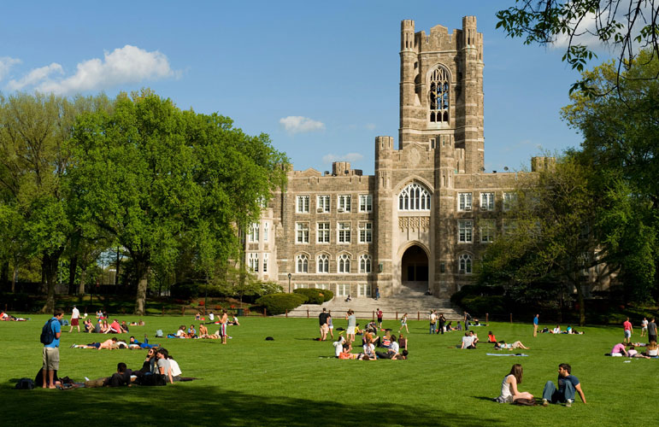
Introduction
It's no secret that US university students often graduate with debt repayment obligations that far outstrip their employment and income prospects, which makes us start to think about the murky relationships between future income and university attended.

Slide 4
Introduction
In an effort to make educational investments less speculative, we are trying to identify what kind of universities can cultivate the students who will make a decent income in the future after graduation.

Slide 5
Introduction
The US Department of Education has matched information from the student financial aid system with federal tax returns to create the College Scorecard dataset. With the dataset, we will finally make the returns on higher education more transparent.

Slide 6
Our Data
College Scorecard dataset
Source: Kaggle.com
Objects: School
Raw Data: Data from 7000 schools in the past 20 years
1720 variables--
School, Academics, Students, Cost, Completion,
Admission,Earning, Repayment, Aid, and Root

Slide 7
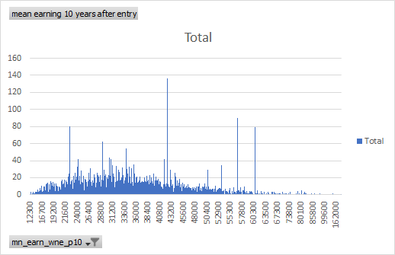
Our Data
Average earning of student working and not enrolled 10 years after entry
Min: $ 12300
Max: $ 250000
Mean: $ 37062
Mode: $ 42300

Slide 8
Methodology
Data Collection
Data Preprocessing
Variable Selection
Model Building
Evaluation

Slide 9
Methodology
Variable Selection
Attributes:
Admission rate (ADM_RATE)
Average SAT equivalent score of students admitted(SAT_AVG)
Predominant degree awarded(PREDDEG)
Enrollment of undergraduate degree-seeking students(UGDS)
In-state tuition and fees(TUITIONFEE_IN)
Out-of-state tuition and fees(TUITIONFEE_OUT)
Proportion of faculty that is full-time(PFTFAC)
Percent of all students receiving a federal student loan (PCTFLOAN)
Percent withdrawn from original institution within 2 years (WDRAW_ORIG_YR2_RT)
Percentage first-generation students (PAR_ED_PCT_1STGEN)
Control of institution(CONTROL)
Target:
Mean earnings of students working and not enrolled 10 years after entry(mn_earn_wne_p10)

Slide 10
Methodology
Model building
Decision Tree
Neural Networks
- Training data: 50%
- Testing data: 50%
- Targeted value: Income

Slide 11
Methodology
Model building
Data Processing
To specify the range of the income, we treat the first 33% of the observations as a low income group, the middle 33% as intermediate income group and the top 33% as the high income group.

Slide 12
Methodology
Model building
What can we get from the model ?
- Predictor Importance
- Instance and percentage for each node
- Model summary
- Diagram

Slide 13
Methodology
Model Evaluation
For each model we construct, we would always need to see how accurately the model can predict the data. By introducing two matrices for training and testing data, we will be aware of the accuracy of the model by comparing them together.

Slide 14
Expectation
Ideally, we expect the decision tree to give us the information that students who are the first generation and who have the high SAT scores will have a high income in the future. For those students whose institution have a higher withdrawal rate may not have a good income.

